Slide 1
Secondary education sector project (SESDP) Inception workshop
INCEPTION PLANNING WORKSHOP
October 1-3, 2012
Notes:
March 25-26, 2009

Slide 2
WORKSHOP OBJECTIVES

Slide 3
WORKSHOP OBJECTIVES
formally launch SESDP with PES partners;
provide briefing of specific outputs of SESDP and make PES understand their specific roles;

Slide 4
WORKSHOP OBJECTIVES
(iii) discuss and reach agreement on updated planning for key stage activities to include: (a) site confirmation of LSE schools and dormitories based on the recently completed site validation study. If not possible, figure out an action plan on how to identify school sites that will fit the criteria;

Slide 5
WORKSHOP OBJECTIVES
explain and clarify selection criteria for choosing the 1,740 scholars out of the some 41,000 list derived from the baseline study and provide deadlines for submission of final list with wait list from each province;

Slide 6
WORKSHOP OBJECTIVES
(c) confirm school beneficiaries for the school grants;
central implementing IUs to present targeted outputs 1 and 2;
(v) discuss detailed implementation procedures as well as ADB/MOF related guidelines and schedules.

Slide 7
Some Tips on Project Management: Why Projects Go Wrong…

Slide 8
Many things can go wrong in project management. These are due to ‘barriers’ such as…

Slide 9
Poor Communication Many times a project may fail because the project team does not know exactly what to get done or what's already been done.

Slide 10
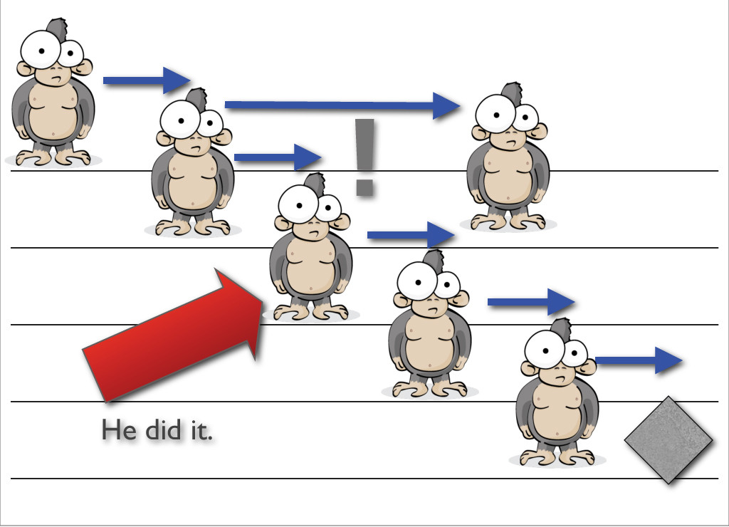
Disagreement
Project must meet all elements in a contract.
Consultants and the PIU must agree on various elements.
Failure to comply with standards and regulations.

Slide 11
Why Projects Go Wrong
Poor management
Poorly defined project goals
Inclement weather
People’s (lack of) Support
Personality conflicts
Availability of funds

Slide 12
HOW DO WE MANAGE SUCH BARRIERS?

Slide 13
What is a SMART Goal?
What is a Goal?
PRESENTATION BY AJARN LY FOUNG

Slide 14
THANK YOU!
Kop Chai Lai Lai

